Slide 1
8086 Addressing Modes

Slide 2
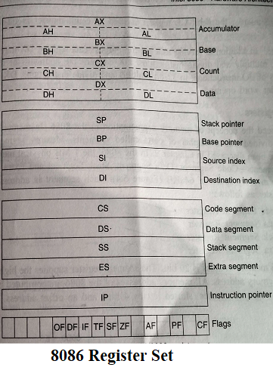
8086 Register Set
Data Register group(AX,BX,CX,DX)
Segment Register group(CS,DS,SS,ES)
Pointer and Index Register group(SP,BP,SI,DI)
Instruction pointer(IP)
Flag Register

Slide 3
The various formats/ways for specifying operands in the instruction are called addressing modes.
8086 has the following eight types of addressing:
1. Immediate Addressing Mode
2. Direct Addressing Mode
3. Register Addressing Mode
4. Register Indirect Addressing Mode
5. Based Plus Index Addressing Mode
6. Register Relative Addressing Mode
7. Based Plus Index Register Relative Addressing Mode
8. String Addressing Mode

Slide 4
Immediate addressing
One of the operand is included in the instruction itself.
Ex: MOV AX, 0020H (The operand(0020H) is stored in the register(AX))
ADD CX, 2387H
Register Addressing Mode
Register Addressing Mode the data is stored in a register and it is referred using the particular register.
Ex: MOV AX, BX (copies the contents of the 16-bit BX register into ; the 16-bit AX register)
Direct Addressing Mode
In the direct addressing mode, a 16-bit memory address (offset) is directly specified in the instruction as a part of it.
Ex: MOV [3624H], DX
-It copies the contents of DX register into the location calculated from Data Segment Register and offset 3624H

Slide 5
Ex: OR AL,(3030H)
-OR the contents of AL register with the contents of memory locaion calculated from DS register and offset 3030H
Register Indirect Addressing Mode
In this Addressing Mode, the offset is specified through pointer register or index register.
For index register SI and DI register may be used.
For pointer register, BX(Base Register) or BP(Base Pointer) may be used.
Ex: ADD CX, [BX]
Here data is present in a memory location in DS whose offset address is in BX.
Based Plus Index Addressing Mode
This type of addressing mode is used when an array of data is to be accessed.
It is the extension of Register Indirect Addressing Mode.
BP/BX and SI/DI are used to indirectly address the memory location.

Slide 6
Ex: MOV (BX+DI),AL
-BX contains the offset to address the location of the beginning of the array.
Register Relative Addressing Mode
Similar to Base Plus indexing addressing mode.
The offset is calculated using either BP/BX or SI/DI and the displacement specified as an 8-bit or 16-bit number as part of the instruction.
Ex: MOV AX, (DI+06)

Slide 7
Base Plus Index Register Relative Addressing Mode
Combination of Base plus Index Register Addressing and Register Relative Addressing mode
Ex: MOV(BX+DI+2), CL
String Addressing Mode
Apart from segment registers, the index registers SI and DI are used.

